Slide 1
MovieS
By: Kamaneeya Kalaga, Hui-Chen Betty Liu, Kayla Reiman, Sinduja Sriskanda
Notes:
SOCIALLY CONSCIOUS

Slide 2

Notes:
INSERT FUNNY GIF

Slide 3

Notes:
INSERT FUNNY GIF

Slide 4
What it does
A movie database with information about the cast, crew, and Bechdel test scores.
Search from a database of movies that have this information included!
Notes:
How do you know if a movie is worth watching?
Or check that the movie you are about to watch corresponds with your values?
Objective: being able to access a database that assesses socially conscious films
Uses: See how well your favorite film stands, if you are interested in socially conscious movies

Slide 5
SOURCES OF Data
Sindu - CSV
Betty - API
Kamaneeya - Web Scraping
Kayla - Data Merging
Notes:
Each person in charge will briefly overview what they did, where did their source of data come from, and what was the outcome.
Sindu - Kaggle had a competition with a variety of csv files that contained all sort of information such as cast demographics, crew demographics, and movie information. I used the pandas library to convert, manipulate, and merge it all into a useable dataframe for further analysis

Slide 6
FEATURES
Partial Searching
Movie Details
You can partially search names of movie titles
Can see basic information about movie (i.e synopsis)
Bechdel-Test Score
Gender Statistics
Can see bechdel-test score for corresponding movie and it’s interpretation
Can obtain % of women in cast and crew
Notes:
Talk about features → explain what the bechdel test is

Slide 7
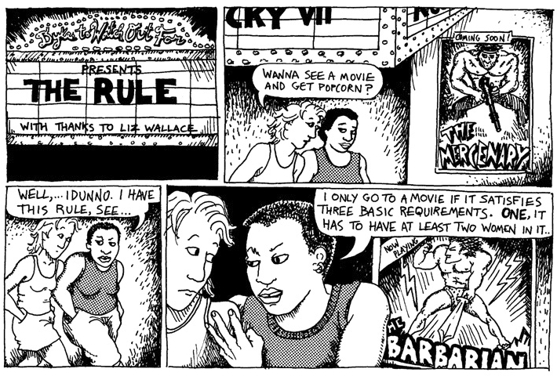

Slide 8
Bechdel Test
This simple test that asks 3 questions:
If there are 2 female named characters, do they speak about something other than a “love interest”?
If there are 2 female named characters, do they speak to each other?
Are there AT LEAST 2 female named characters?
Q2
Q3
Q1

Slide 9

LET'S DO A DEMO :)

Slide 10
Lessons learned
HTML is not hierarchical
Manipulating CSVs aren’t easy
Instead of scraping from main website, scrape from specific URLs under headings.
A data format for one person might not work well for another.
API community
Diversity data are hard to find
A strange error message? You can get support from a community of people working with the same API.
It’s a work in progress. We limited the scope of our project to gender data.

Slide 11
THANKS FOR LISTENING!!
Have a good spring break
(WE MADE IT!)
If you are interested in seeing the data yourself, please see attached GitHub link below:
https://github.com/kaylareiman1/MovieAnalysis

